Slide 1

Predicting Movie Blockbuster Success
By Lean Peria

Slide 2
Goal: Predict which movies will be AAA
The data available does not include box office revenue, only IMDb user ratings
Widely-accepted definition of AAA movie:
Large budget
High-profile actors
Strong box office expectations
We must use revenue data

Slide 3
Data sources
IMDb Non-commercial datasets
User ratings
MovieLens 32M dataset (2023)
TMDB 1M dataset from Kaggle
Release dates
Budget and Revenue

Slide 4
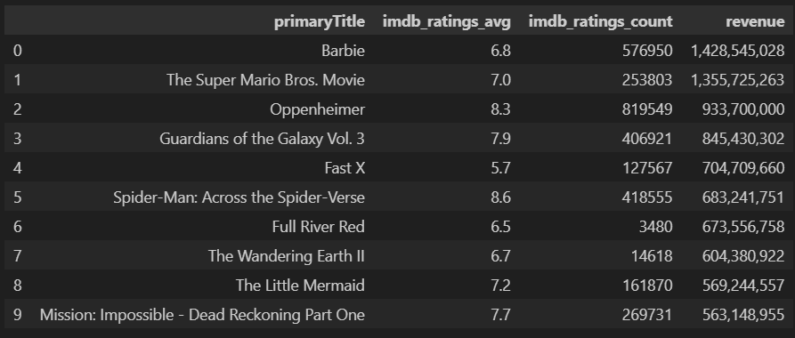
Exploratory analysis
Best performing 2023 movies by revenue

Slide 5
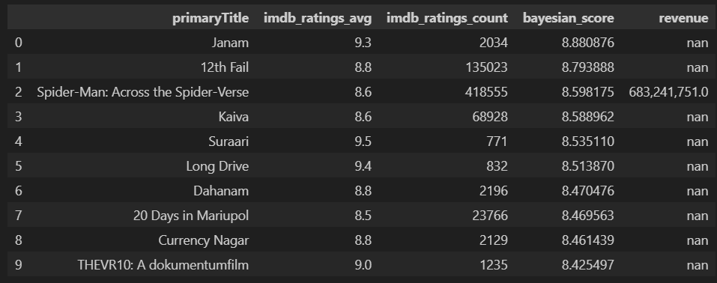
Exploratory analysis
Best performing 2023 movies by Bayesian average rating

Slide 6
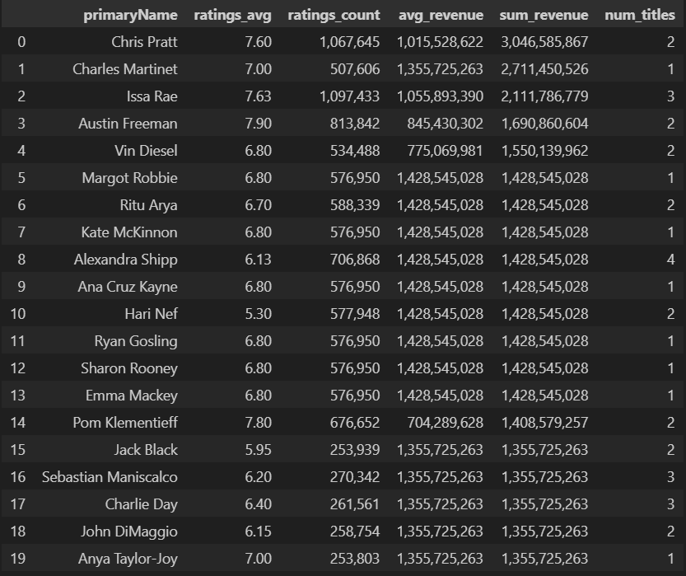
Exploratory analysis
Top actors in 2023 movie revenue
Notice a lot of these actors were in Barbie and Super Mario

Slide 7
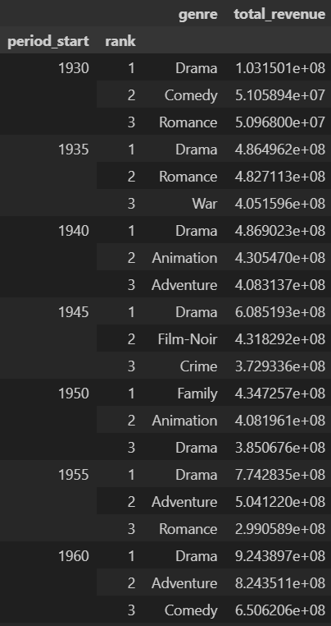
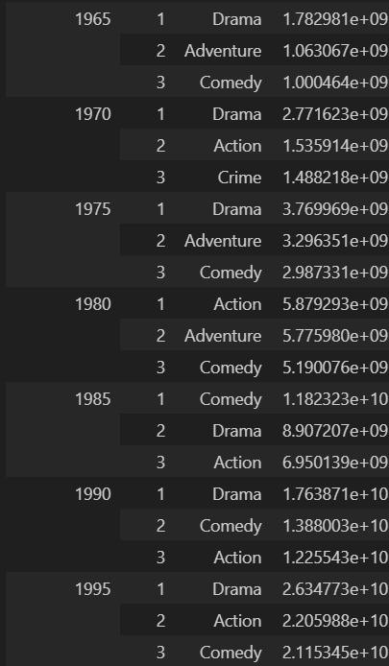
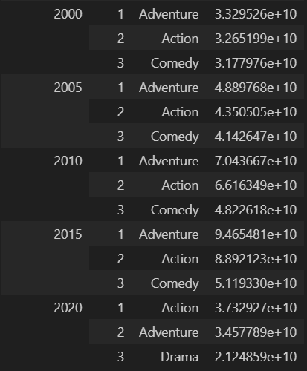
Exploratory analysis
For movie trends, we can examine the top 3 genres by revenue for every 5-year period

Slide 8
Our prediction model
We try to predict the revenue using various features:
Year, week number, day of year, runtime
Genres -> exploded and one-hot encoded
Original language -> one-hot encoded
IMDb ratings average, ratings count, average revenue, total revenue and number of titles for:
The top director (in revenue)
The top writer (in revenue)
The top company (in revenue)
The top 2 actors and all actors in aggregate

Slide 9
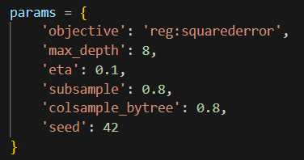
XGBoost Model
We chose the below hyperparameters. Given more time, we could have done Bayesian optimization on them
The model resulted in R² of 0.89!

Slide 10
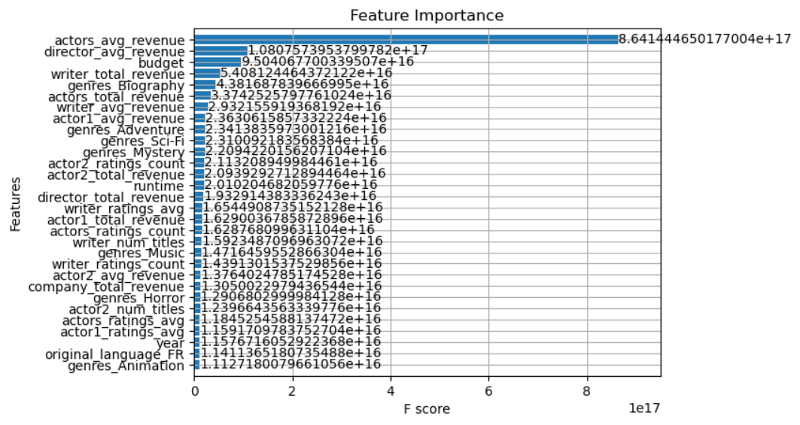
Gain Feature Importance Plot

Slide 11
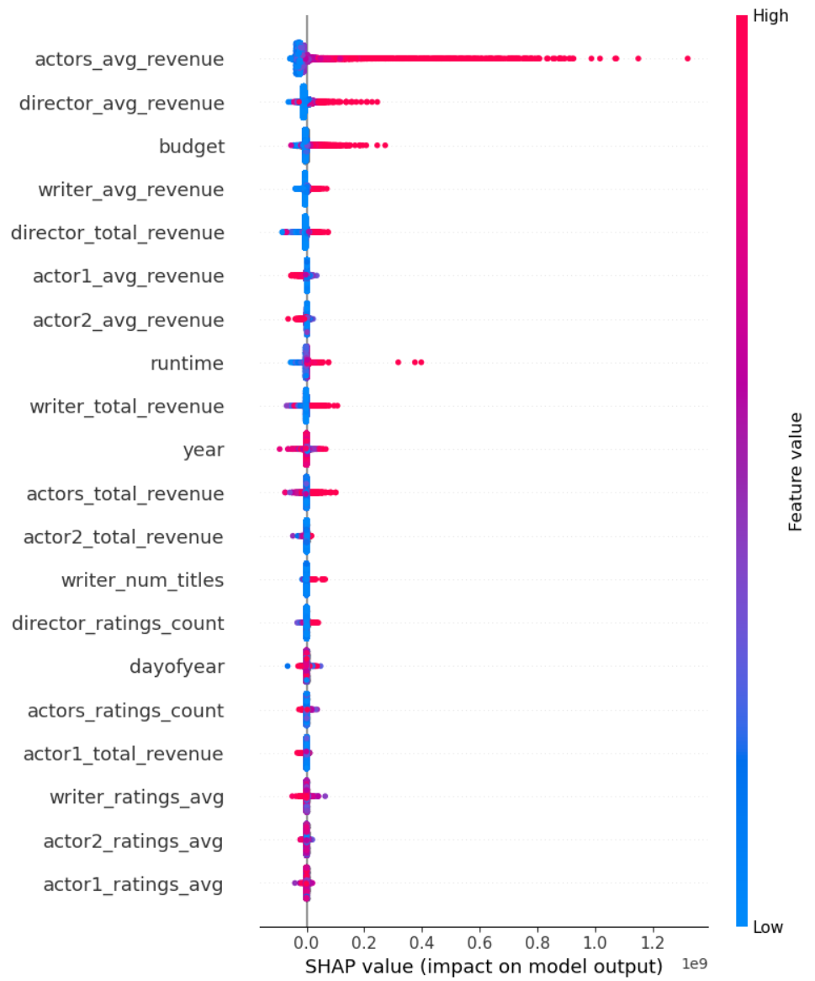
SHAP values plot

Slide 12
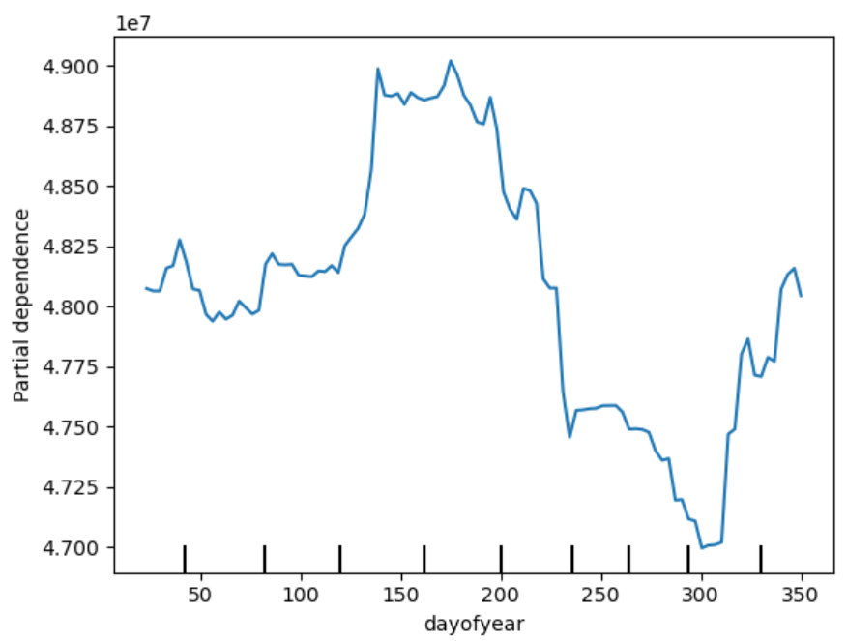
Day of year versus predicted revenue

Slide 13
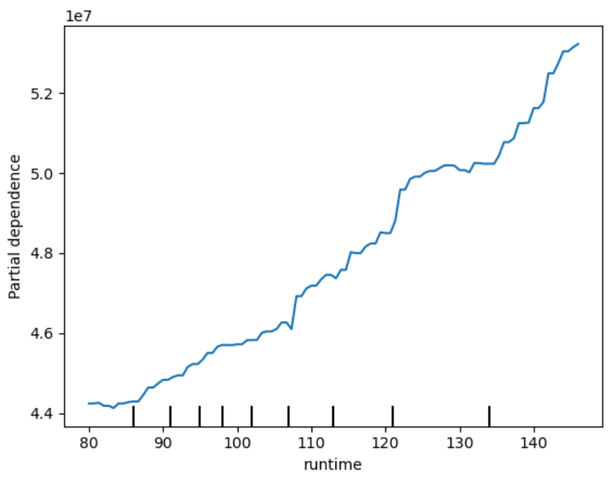
Runtime versus predicted revenue

Slide 14
Findings
Indeed, the most important thing for box office success is having high-profile directors and actors!
Higher budget tends to result in higher revenue
It is best to release during summer
Longer runtime tends to result in higher revenue
Mystery, Drama, Animation and Adventure genres perform well

Slide 15
Alternate prediction model
Given more time, I wanted to use a transformer-based regression model
DistilBERT from HuggingFace
When predicting a movie’s performance, we feed the model a sequence of the previous works of the actors, director and writer for the movie
DistilBERT allows for NLP features
Reference: Sanh et al (2020) DistilBERT, a distilled version of BERT: smaller, faster, cheaper and lighter
(https://arxiv.org/abs/1910.01108)

Slide 16
Thank you!

